Slide 1
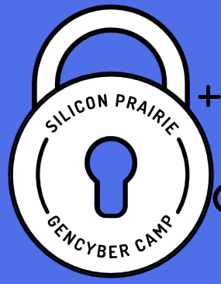




July 18-22, 2016

Slide 2
What the $%$# are we doing here?
Notes:
current security threats; future security trends/issues; the security industry/job market; cyber hacking

Slide 3
Help! Your parents, grandparents, aunts, uncles, etc. don’t know what they’re doing online!

Slide 4
Help! We need more
Cyber professionals!

Slide 5
Admin Stuff Food, Drink, Facilities, Use of Computers

Slide 6
Our objective is to not be like this: https://www.youtube.com/watch?v=uhiCFdWeQfA
Or this: Why you should turn off your cell phone in class
Notes:
Videos

Slide 7
Rulez
Be cool – no ‘tudes allowed
A-B-C = Always Be Curious
Don’t be afraid to try
Leave the world a better place – If you make a mess, clean it up (IRL or OL)

Slide 8
Safety Stuff or How to Survive a Disaster
Tornado / Severe weather
Fire
Power Outage
Active shooter
Zombiepocalypse

Slide 9
Be Safe Be Smart Have fun Online
Notes:
Hacking is happening whether you know it or not. Are you part of the solution or part of the problem? In this interactive session, Professor Woerner discusses the mindset of hackers and what you need to do to protect yourself on and off line. This presentation also covers current security threats, future security trends/issues, and the security industry/job market. Come to this session and learn, “R U a H@cker?”

Slide 10
Identity Paradox
Who am I?
How do you know?
How do I prove it to you?
Without compromising my privacy?

Slide 11
Staff Introductions
Doug Rausch
Ron Woerner
Gary Sparks
Therese Laux
Luke Ring

Slide 12
Student introductions
Get into your groups

Slide 13
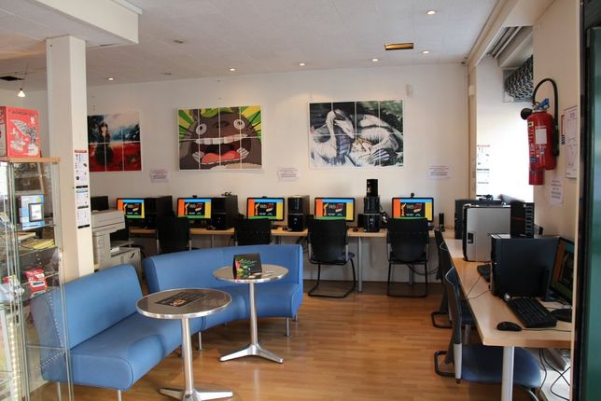
Scenario
Silicon Prairie Cafe
Notes:
You have been recently hired as a cybersecurity specialist at Silicon Prairie# Corp. They are an online gaming company that provides servers for gamers. Their primary product is Minecraft and they currently run 3 domains on multiple Linux servers. They bill the community for use of the servers and want to keep billing software separate from the gaming sites. The billing is run on a Windows 2012 Server using MSSQL. The administrative staff use Windows 7 PCs. There’s a webserver with the company’s website using Apache on Linux. The company uses a cloud based email provider.

Slide 14

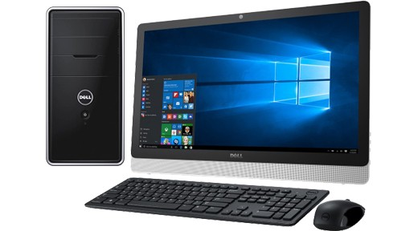
Take out your computer

Slide 15
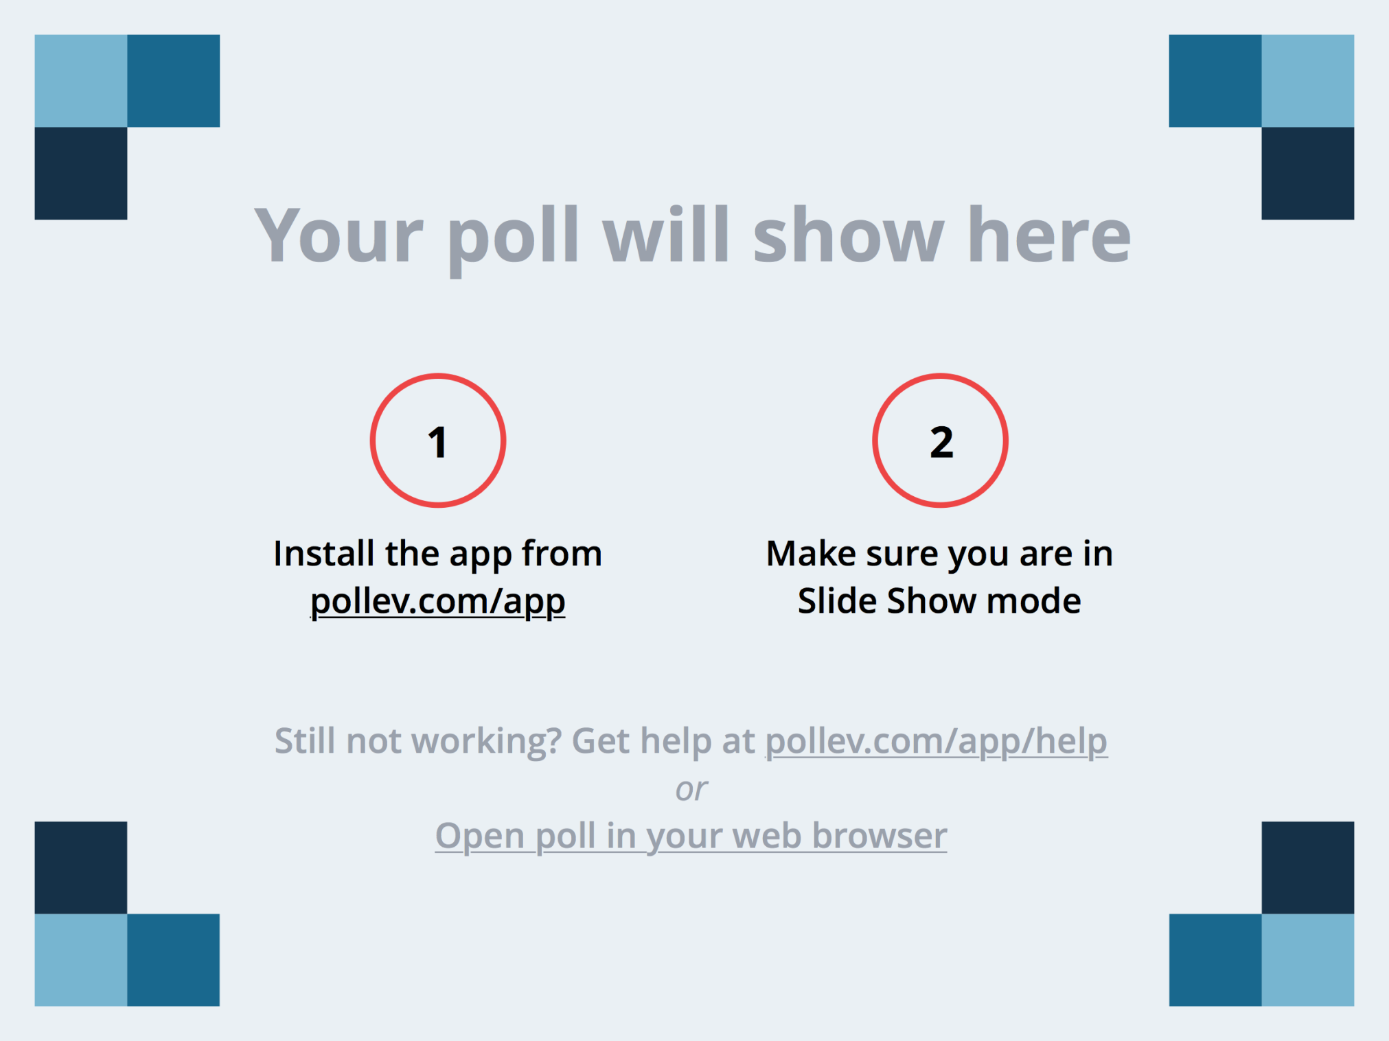
Notes:
Audience can respond atPollEv.com/funbread355
Presenter session: Audience textsFUNBREAD355 to 22333 to join the session, then they text A, B, C, D, or E

Slide 16
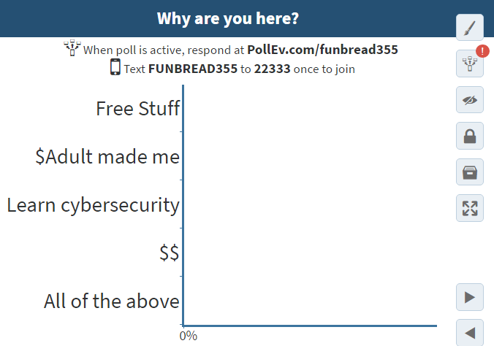
Poll #1
Notes:
Audience can respond atPollEv.com/funbread355
Presenter session: Audience textsFUNBREAD355 to 22333 to join the session, then they text A, B, C, D, or E

Slide 17
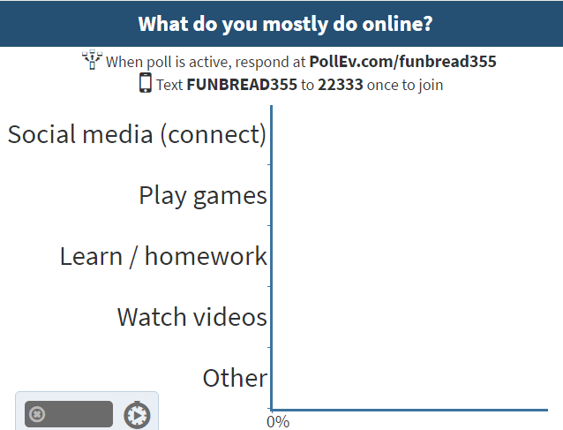
POLL #2
Notes:
Audience can respond atPollEv.com/funbread355
Presenter session: Audience textsFUNBREAD355 to 22333 to join the session, then they text A, B, C, D, or E

Slide 18
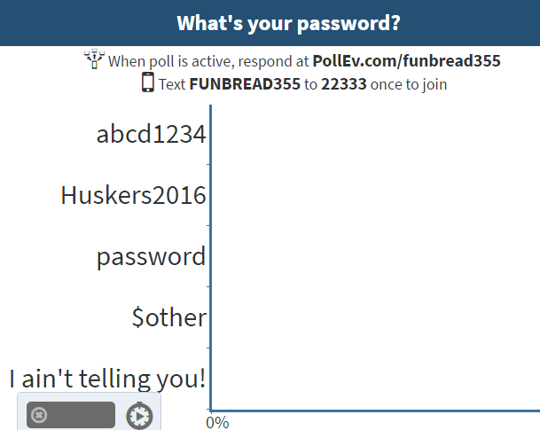
POLL #3
Notes:
Audience can respond atPollEv.com/funbread355
Presenter session: Audience textsFUNBREAD355 to 22333 to join the session, then they text A, B, C, D, or E

Slide 19
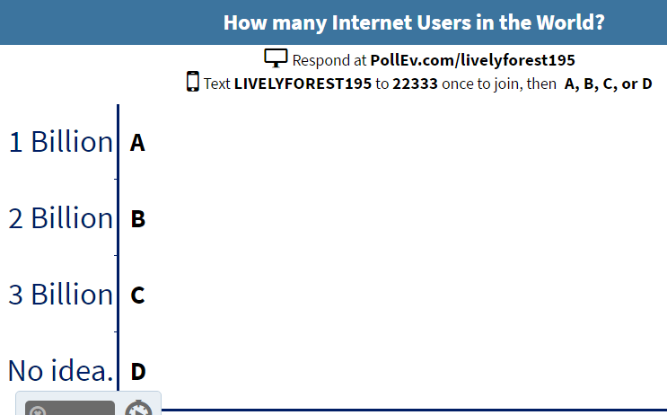
Notes:
http://www.internetworldstats.com/stats.htm

Slide 20
What % of people are bad?
Now let’s do some math…
X% of Y = ???
X is % of people are really bad
Y is number of people on the Internet
1% of 3Billion = 30,000,000
Notes:
1% of 3Billion = 30,000,000

Slide 21
Cybersecurity First Principles
Domain Separation
Process Isolation
Resource Encapsulation
Least Privilege
Layering
Abstraction
Information Hiding
Modularity
Simplicity of Design
Minimization
Notes:
Explain what each of these are

Slide 22
If it ain’t yours, don’t mess with it without permission.
A quick
message on
Ethics

Slide 23
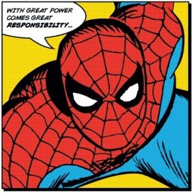

Slide 24
Why you need to pay attention
$82,000

Slide 25
Help! We need more
Cyber professionals!

Slide 26

Basically:
We’re
Pwnd
We’re
Screwed
Notes:
current security threats; future security trends/issues; the security industry/job market; cyber hacking

Slide 27
R U
a
H@cker?

Slide 28
Hacking Techniques
Vulnerability Hacking
Web Hacking
Google Hacking
Social Engineering
Stupidity Hacking

Slide 29

#1 Hacking Tool
https://www.google.com/advanced_search
Notes:
http://blog.hubspot.com/blog/tabid/6307/bid/1264/12-Quick-Tips-To-Search-Google-Like-An-Expert.aspx

Slide 30
CyberSecurity Tips
Play nice – Don’t bully
Keep your devices and applications current (apply updates)
Protect your PI (personal information)
Use a strong password or MFA
Be web wise. Learn how to secure yourself and others.
Trust, but verify

Slide 31

Notes:
future security trends/issues; the security industry/job market

Slide 32
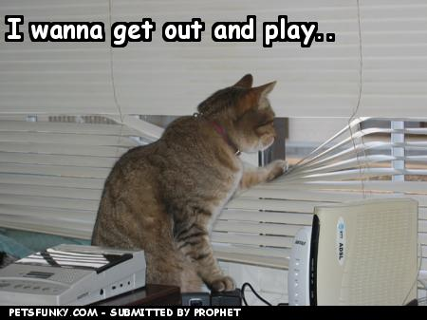
Notes:
B Curious.
Play and learn

Slide 33


Remember
https://www.stopthinkconnect.org/

